Slide 1

Full text search with Elasticsearch
Przemysław Gumuła
Allegro
Platinum Sponsor

Slide 2


?

Slide 4
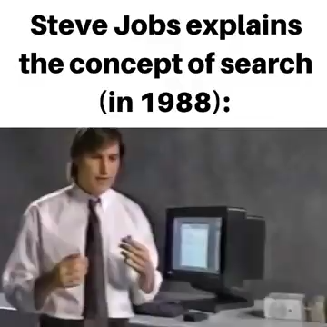
Notes:
Steve Jobs explains what search is (look at the year!)
~10 years before Google was founded!
Steve Jobs was known as a man that knows what people want before they realize they want it
Mówi, że interesuje go przyszłość (trochę gra słów)
32 years later the world is a different place. What are your options when you want to have a search bar in your website

Slide 5
Sadarama, CC BY-SA 4.0 via Wikimedia Commons
Notes:
imagine your grandma really likes knitting
She can knit everything - from swimsuits, through sweaters to coats
She comes to you and asks you for help setting up an online store where she can sell her merch
The requirement is people should be able to look for stuff using a search bar
You need a search engine. What do you do?
Find an existing one and use it
create a startup, get funding, dedicate a few years, and create a new, state-of-the art one
That’s like 50/50
Grandma has already made a lot of clothes, like she can’t even leave hear room cause the door is blocked
let’s assume we want to use an existing one

Slide 6
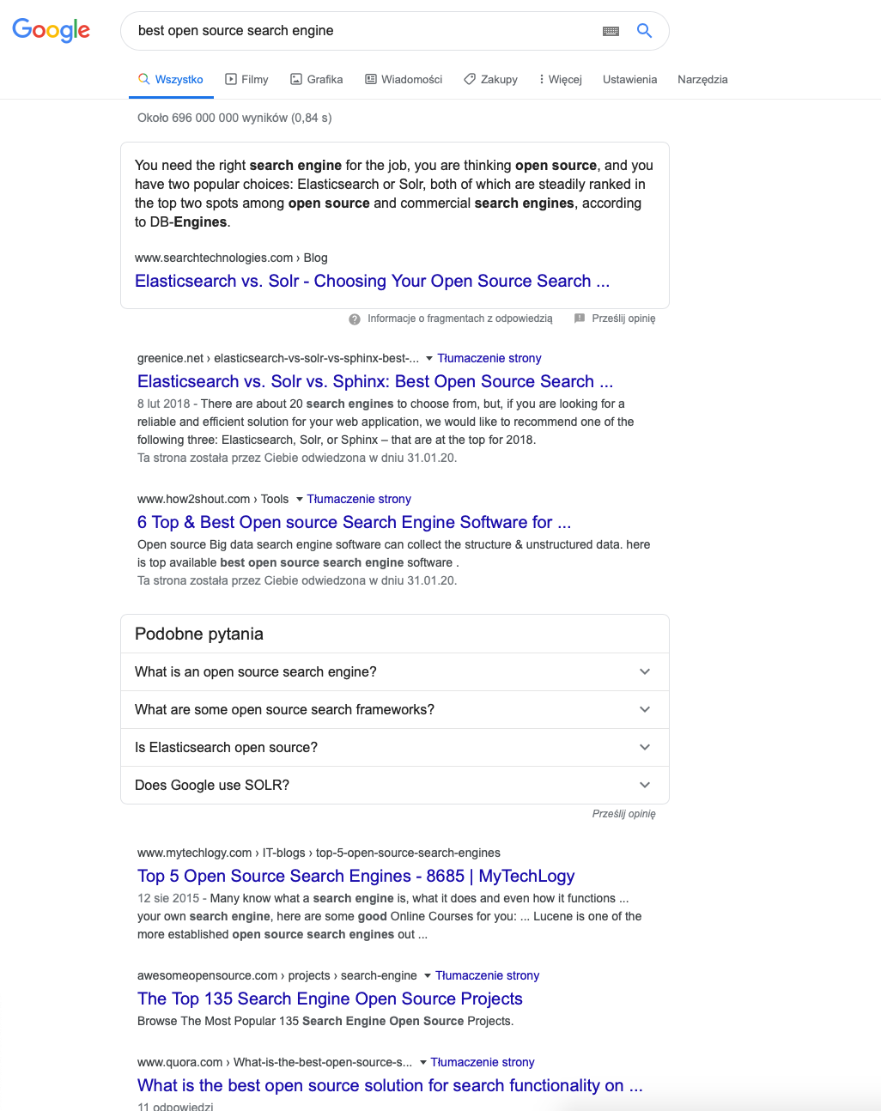


Notes:
Szukamy w Googlach - może coś już jest?
Pierwsze wyniki - coś chyba jest. Kolejne - 6 top - (obrazek wtf) czyli jest co najmniej 6, spoko!
Widzę, że popularny jest jakiś Solr i jakiś Elasticsearch
Szukamy dalej

Slide 7

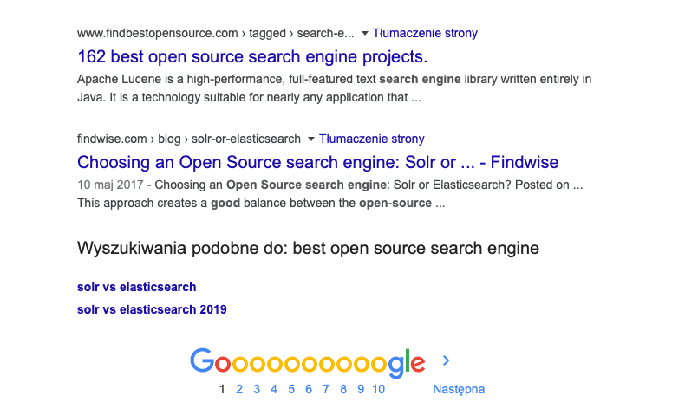

Notes:
WTF?
There’s a lot of existing tools - we need to choose one

Slide 8

https://dribbble.com/shots/7107741-Time-passing-gif-animation
Notes:
Time flies by, you’re looking, reading, comparing…
And decide on…

Slide 9

Notes:
Elasticsearcha.
nie wiem, czy ES jest najlepszy, ale od kilku lat szybko się rozwija
sama firma Elastic offers a whole ecosystem of products with streamlined integration capabilities

Slide 10

https://all-free-download.com
Notes:
- we’re going to have a store, so first we need to have an index to store products in
Index = database table
To create index you need mapping
Mapping = schema

Slide 11
PUT /test
{
"settings" : {
"number_of_shards" : 1,
„number_of_replicas" : 2
},
"mappings" : {
"properties" : {
"field1" : { "type" : "text" }
}
}
}
Notes:
Mapping is more than a schema
information about which fields are going to be stored and indexed
Technically no need to add a schema manually - it will be created dynamically
You don’t want that in a prod environment - I once lost 2 days because of bad mapping

Slide 12
{
"mappings": {
"properties": {
"title": {"type": "text"},
"description": {"type": "text"},
"price": {"type": "integer"},
"fabric": {"type": "text"},
"color": {"type": "text"},
"note": {"type": "keyword", "index": false}
}
}
}
Notes:
We create an index
- we’re interested in the mappings

Slide 13
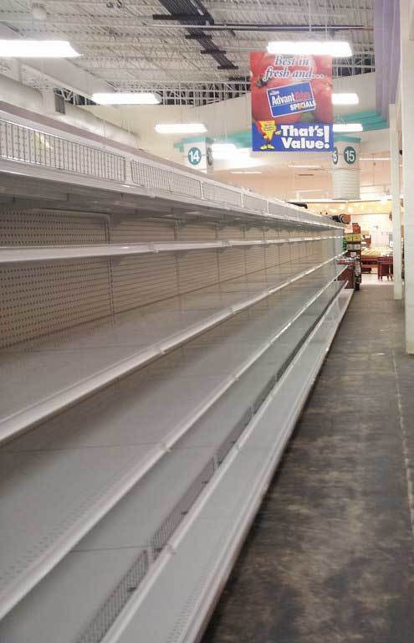
Oversold on the left, Overbought on the right "Empty shelves at a grocery store" by Chris Waits
Notes:
Mapping created, Shelves are there, but there’s no merchandise
You can find this script on github
Generating products and inserting them into the index
(Otwieram skrypt, pokazuję co tam jest, a później uruchamiam). (Następnie włączam count query i pokazuję, że jest już > 0 ).
Here’s the count query

Slide 14
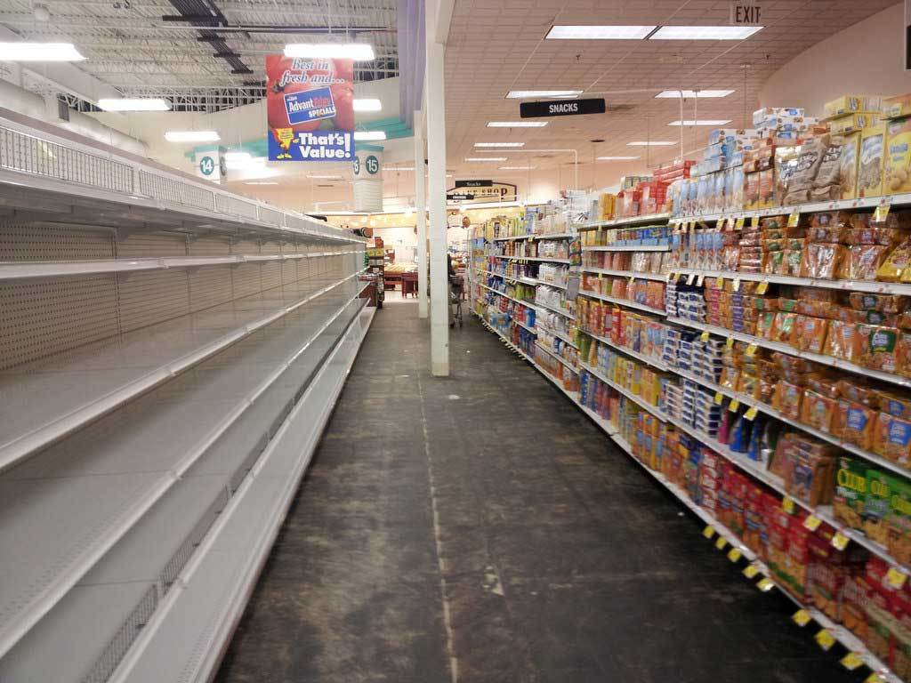
Oversold on the left, Overbought on the right "Empty shelves at a grocery store" by Chris Waits
Notes:
Here’s how our store looks now
Możemy już czegoś w indeksie poszukać.

Slide 15
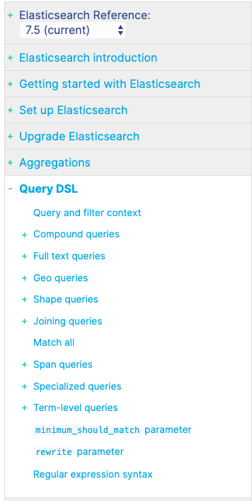
https://www.elastic.co/guide/en/elasticsearch/reference/current/query-dsl.html
Notes:
Elasticsearch search api Is rich and well-documented

Slide 16

https://www.elastic.co/guide/en/elasticsearch/reference/current/query-dsl.html
Notes:
We’ll focus on full text search, the one that has to do with search bars

Slide 17
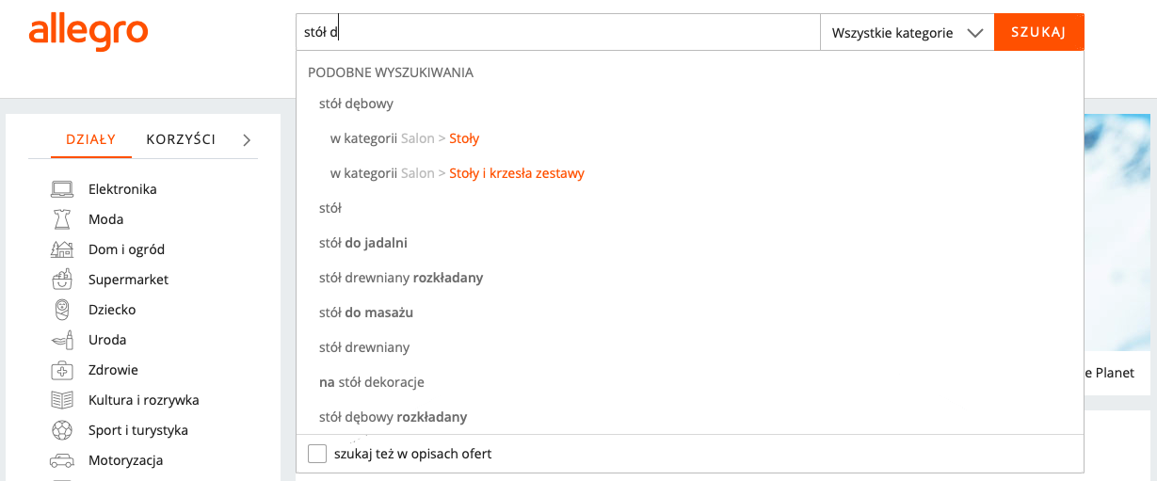
Notes:
Autocomplete is useful in online stores
in Elasticsearch simplest way is set the field type to „search_as_you_type”
Example

Slide 18
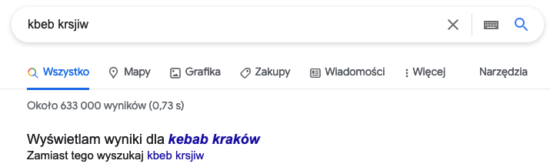
Notes:
każdy, komu zdarzyło się kiedyś w życiu za dużo wypić wie, jak trudno korzysta się wtedy z klawiatury.

Slide 19
Notes:
Let’s open postman

Slide 20
INDEX
Notes:
Ale zacznę od nieco bardziej teoretycznego wstępu.
Who knows what an index is? (A regular db index)
Właściwie zbiór informacji o produktach

Slide 21
INDEX
Notes:
Inverted index?
Why is it called inverted?

Slide 22
Charlie and the chocolate factory | fantasy, family
The Godfather III | drama, gangster
Iron Man | action, sci-fi
Spider-Man | action, sci-fi
Notes:
chcecie stworzyć nowy silnik wyszukiwania.
Jego elementem będzie właśnie indeks.
forward index - cinema listing - movies and genres
Easy to add movies
We want to search for action movies
Need to check all records - can take a long time
Let’s invert the dependency - key is the genre
Searching will be easy, but adding movies will be harder

Slide 23
fantasy | Charlie and the Chocolate Factory
family | Charlie and the Chocolate Factory
drama | The Godfather III
gangster | The Godfather III
action | Iron Man, Spider-Man
sci-fi | Iron Man, Spider-Man
Notes:
This is an inverted index
That’s how it’s done in elasticsearch
Genres are phrases
Movies are the documents in index

Slide 24

https://planetamarvel.net/nicolas-cage-into-the-spiderverse/

Slide 25
Doc_1 — “In the summer the quick brown fox jumps over the lazy dog”
Doc_2 — “The quick brown fox jumped over the lazy dog!”
Notes:
example
rozłożę teraz te dokumenty na pojedyncze znaki
Dzielę na tokeny (wyrażenia) po spacji i na razie nie robię nic innego

Slide 26
Doc_1 — “In the summer the quick brown fox jumps over the lazy dog”
Doc_2 — “The quick brown fox jumped over the lazy dog!”
Term | Doc_1 | Doc_2
In | x
the | x | x
summer | x
quick | x | x
brown | x | x
fox | x | x
jumps | x
over | x | x
lazy | x | x
dog | x
The |  | x
jumped |  | x
dog! |  | x
Notes:
Jak Wam się podoba ten indeks? Co Waszym zdaniem można zrobić inaczej?
Capital letters should be lower-cased?
depends. On what?
What we want to be found

Slide 27

Notes:
We can configure it
How it works in elasticsearch
Text - a piece of website with html tags, encoded chars and a non-ascii symbol
This is our document and we need to index it

Slide 28
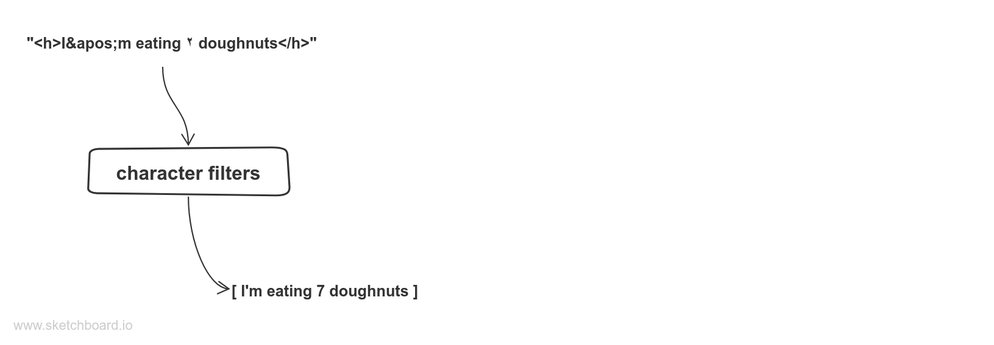
Notes:
- character filter is first
Możemy oczywiście zdefiniować customowe filtry
Can map one char into another (arabska 7)
Can remove chars (html strip filter)
Can use regex

Slide 29
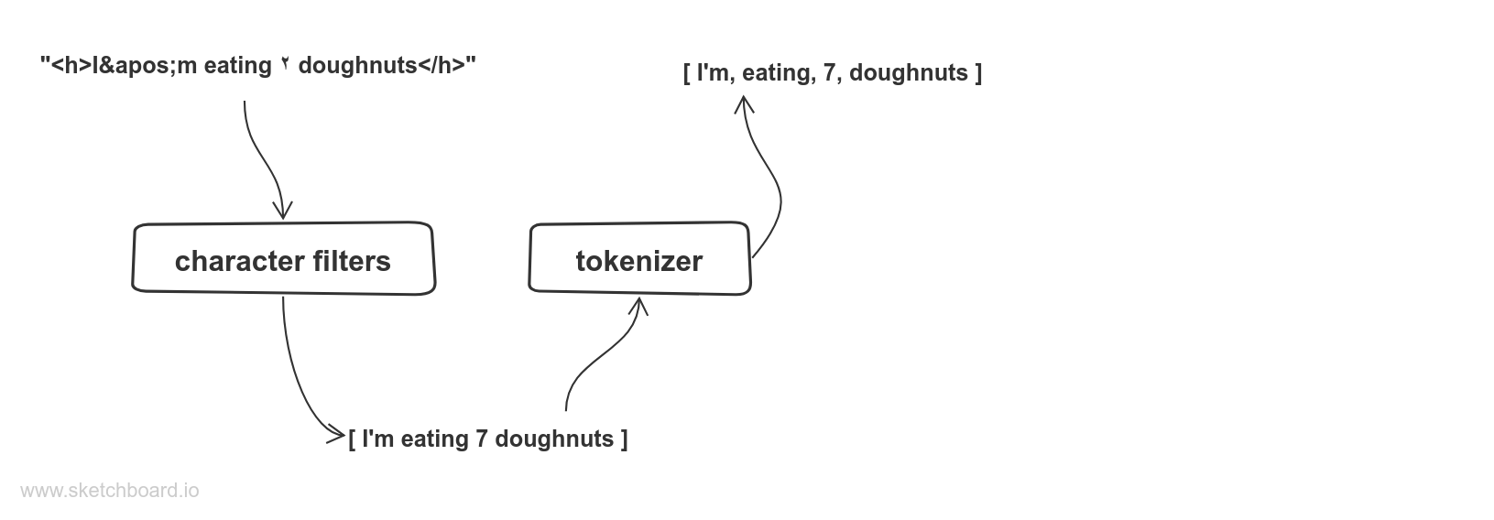
http://unicode.org/reports/tr29/
Notes:
Still a raw string
Need to split it into tokens
Tokenizer takes a string and outputs a list of tokens
Can split by whitespace, but it’ too simple
Can create a custom tokenizer
Standard tokenizer splits according to a standardized algorithm - “dog’s” is one word, Brown-Foxes are 2

Slide 30
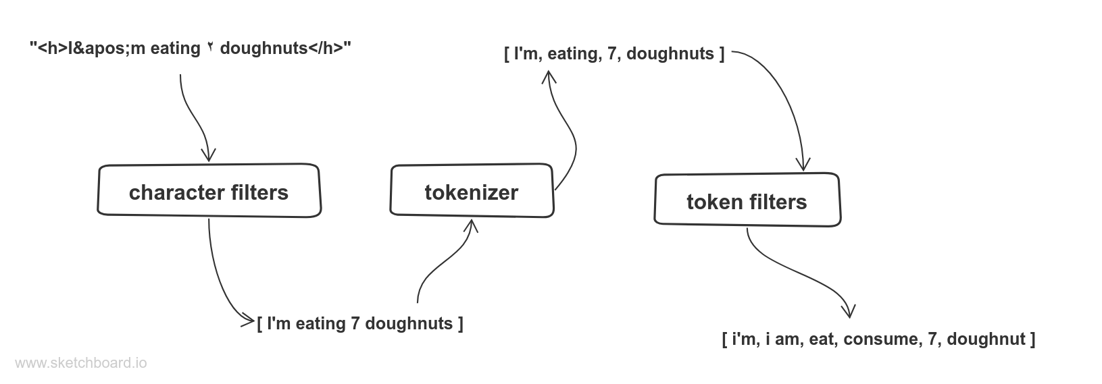
Notes:
Token filters
We usually want capital and small letters to be treated as same
Lowercase filter
stopword filter removes tokens that are typically known as stopwords „the, a, is”
Synonym filter adds similar words to the index

Slide 31
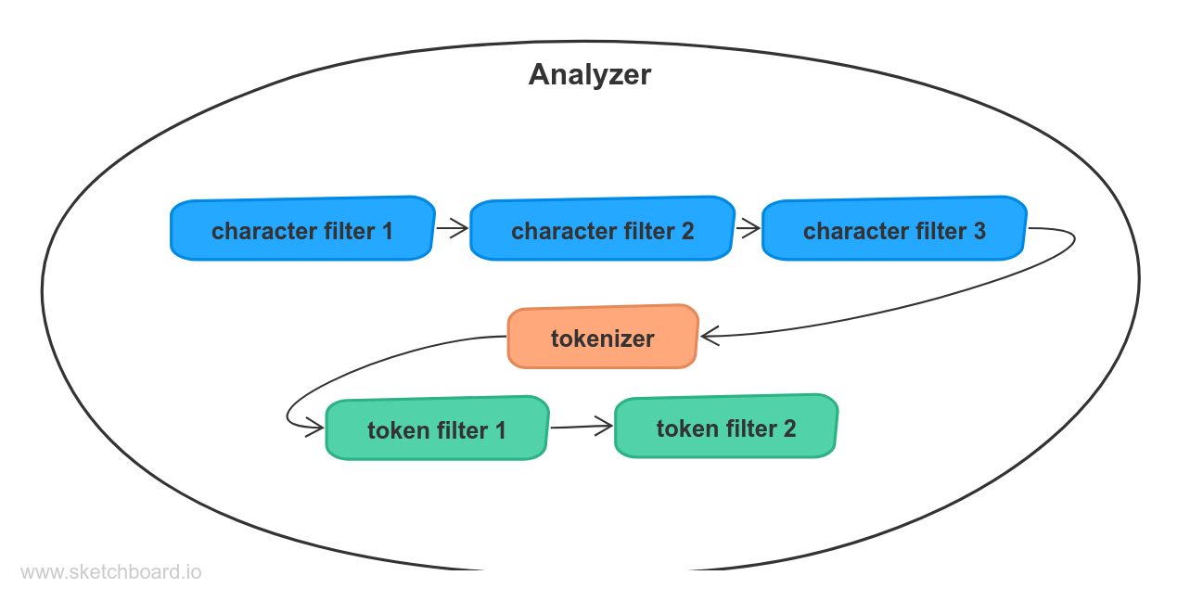
Notes:
char filters, tokenizer i token filters - form an analyzer
You can create a great search system with them, but also a terrible one
- can use ready-made analyzers
Can use a ready-made analyzer and switch one part of it
Can create a custom analyzer
Can test analyzers: https://www.elastic.co/blog/found-text-analysis-part-1
Examples

Slide 32
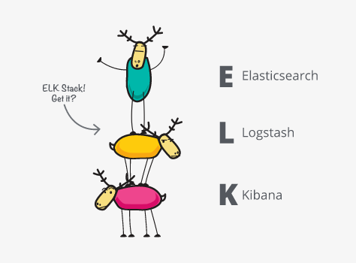
https://www.elastic.co/what-is/elk-stack
Notes:
ELK stack składa się obecnie z 4 aplikacji - Elasticsearch, logstash, kibana i beats.
Początkowo beatsów nie było, stąd nie ma “b” w skrócie.
ELK stack to poważna część systemu mikrousług - możemy zbierać logi (logstash), indeksować je (elasticsearch) i wizualizować (kibana).
Dzięki beatsom możemy też dodać metryki.
I mamy duży kawałek infrastruktury mikrousług.

Slide 33
Questions?
Share your feedback!
https://github.com/gumula/elasticsearch101

